Slide 1


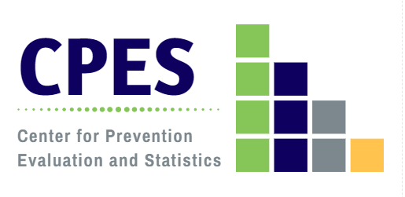
The State of the State:
Substance Use in Connecticut
A presentation to the
State Epidemiological Outcomes Workgroup (SEOW)
March 20, 2024
DMHAS Center for Prevention Evaluation and Statistics (CPES)
at UConn Health

Slide 2
Objectives
Describe the state of substance use and misuse in Connecticut in terms of:
  prevalence of use and misuse;
  perceptions and consequences related to use and misuse;
Explore trends in substance use/misuse and consequences over time;
Illuminate substance use- and misuse-related concerns, risk groups, and priorities.
1

Slide 3
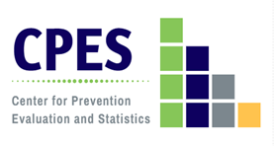
Substance Use
Percent of Persons (Ages 12+) Reporting Use by Substance, 2021-2022
Reported past month alcohol use was most prevalent among respondents aged 26 and older (61.2%).
Reported past month marijuana/cannabis use
was most prevalent in young adults 18-25 (30.0%).
Note: Tobacco products include cigarettes, smokeless tobacco (i.e., snuff, dip, chewing tobacco, or snus), cigars, or pipe tobacco.
Heroin data was only reported by adults (ages 18+).
Substance use by substance varies in reporting time (i.e., past month vs past year use).
2
Source: NSDUH, 2022
Notes:
+This table, based on NSDUH data, shows the historical reality of substance use in CT vs. the nation: CT typically has higher rates of use than found nationally with a few exceptions.
*Heroin use data was only reported by adults
One of those exceptions has been prescription pain reliever misuse. Our rates have not been significantly different from the national average since I first started monitoring substance use trends in the state 20 years ago. We have, however, had historically higher rates of heroin use (and treatment admissions) compared to the US for decades.

Slide 4
Substances of Greatest Concern in CT Communities
Problem Substances of Greatest Community Concern for Age Groups according to Key Informants in CT, 2022
3
Source: Community Readiness Survey 2022
Notes:
2022 CRS shows problem substances of greatest use
Weighted percents
Alcohol more concerning as age increases
Marijuana/Hashish/THC and vaping sometime tied together for 18-25 year olds
Alcohol and prescription drugs tied together for elderly

Slide 5
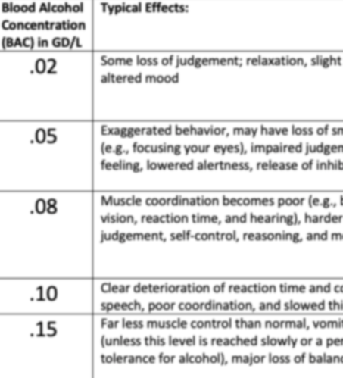
Alcohol
4

Slide 6
Alcohol Use
Past Month Alcohol Use by Age Group in CT, 2015-2022
Note: The 2015 NSDUH underwent significant redesigns. In 2015 the threshold for binge drinking changed for women from 5 or more alcoholic drinks to 4 or more alcoholic
drinks on the same occasion.
*State estimates for these years are no longer available due to methodological concerns with combining 2019 and 2020 data.
5
Source: NSDUH 2015-2022
Notes:
*State estimates for these years are no longer available due to methodological concerns with combining 2019 and 2020 data. 14-15: changes in drinking definition for female 19-20: methodological concerns of survey administration; mix of definition
Definition change prior to 2015 which is why the trend data does not go back further than that
The dash line signifies a gap in data; is not a trend line
2021-22 data may be impacted by COVID; response rates seem to be lower
Overall alcohol use is decreasing for youth population
SAMHSA Statement for 2019-2020 NSDUH data:
State estimates for these years are no longer available due to methodological concerns with combining 2019 and 2020 data. We apologize for any inconvenience or confusion this may cause.
To protect the safety of field staff and survey participants during the COVID-19 pandemic, SAMHSA decided to suspend in-person NSDUH data collection on March 16, 2020. To reduce the impact of the COVID-19 pandemic on NSDUH data, SAMHSA approved the addition of web-based data collection, and in Quarter 4 of 2020 (i.e., October to December), it became the primary forms of NSDUH data collection. Conventional in-person data collection was carried out wherever it was considered safe to do so based on county- and state-level COVID-19 metrics; however, in the fourth quarter of 2020, most respondents answered the survey via the web. Because of the various demographic groups participating in the survey, and the fact that individuals approach the questions differently depending on the context of the question, it is known that people may respond to the survey differently while taking it in-person versus online. Thus, introducing what is called a mode effect.
The potential for a mode effect to affect comparisons and trends between 2019 and 2020 was known when the state estimates were published. However, the initial assumption was that the mode effect was similar for different groups of people, so calculating the average across 2019-2020 would produce statistically valid results. Further analyses that included data from the 2021 NSDUH has shown that this assumption cannot be made. Because of these analyses, along with concerns about the rapid societal changes in 2020, it was determined that averages across the two years maybe misleading. Therefore, as explained above, the state estimates for 2019-2020 are no longer provided.

Slide 7
Heavy Episodic (“Binge”) Drinking
Past Month Binge Drinking by Age Group in CT, 2015-2022
Note: The 2015 NSDUH underwent significant redesigns. In 2015 the threshold for binge drinking changed for women from 5 or more alcoholic drinks to 4 or more alcoholic
drinks on the same occasion.
*State estimates for these years are no longer available due to methodological concerns with combining 2019 and 2020 data.
6
Source: NSDUH
Notes:
*State estimates for these years are no longer available due to methodological concerns with combining 2019 and 2020 data. 14-15: changes in drinking definition for female 19-20: methodological concerns of survey administration; mix of definition
The dash line signifies a gap in data; is not a trend line
2021-22 data may be impacted by COVID; response rates seem to be lower; results should be interpreted with caution

Slide 8
Alcohol Use & Binge Drinking Among High School Students
Percent of High School Students Reporting Past 30-Day Alcohol Use and Binge Drinking in CT, 2011-2021
Note: *Caution should be taken when comparing CSHS 2021 data to that of previous years due to differences in methodology in survey collection.
7
Source: CSHS (CT YRBS) 2011-2021
Notes:
The YRBS trend data for the same period of time validates the results of the NSDUH trends; whether a household personal interview or an in-school group administration, both data sets show the decrease in underage drinking. Downward trends in CT also mirror a downward trend at the national level for the same time period.
The comparison of the YRBS and NSDUH data, however, indicate that the method of data collection do impact the level of reporting, with anonymous, group-based administration resulting in approximately twice the prevalence of reported alcohol use among adolescents. It should be further noted that the NSDUH includes a broader age group (12-17) than the YRBS which primarily includes 14-17 year old high school students. It is likely that the NSDUH underreports that actual prevalence of substance use behavior.
The 2021 CT School Health Survey prevalence estimates and trends have likely been impacted by some significant factors unique to the 2021 CSHS administration.
The CSHS has always been administered in the Spring semester of the school year. Due to COVID-19 impact on in-person learning, the CDC allowed for the survey to be delayed to the fall semester later in 2021. From other states experiences, it has been found that risk behaviors tend to be lower in the fall semester compared to the spring.
Some questions on the CSHS ask students about their behavior in the prior 12 months. In the fall of 2021 that time period would have included when COVID-19 precautions limited opportunities for social interaction both at school and extracurricular.
While non-response bias analysis indicated that 2021 CSHS data was representative, the overall sample size has reduced the ability to provide prevalence estimates by subgroups for certain indicators. Estimates with Coefficient of Variation (CV) higher than 30 or denominator less than N=30 have been suppressed.
Focus of federal funding on underage drinking may contribute to state and national decreases in underage drinking.

Slide 9
Alcohol Use by Sexual Identity
Percent of High School Students Reporting Past 30-Day Alcohol Use and Binge Drinking in CT, 2021
8
Source: CSHS (CT YRBS) 2021
Notes:
Past month alcohol use and binge drinking is higher in GLB population
GLB population has higher prevalence of most risk factors/behaviors related to substance use as measured in the CSHS/YRBS.
e.g., RF areas: feeling unsafe at school; absences; anxiety and depression; being bullied; living w someone w a substance use issue; riding with a driver who had been drinking, past 30 days.
Can find substance use breakdown by other minority groups on DPH website

Slide 10
Key Takeaways: Alcohol
Alcohol remains the substance of highest use prevalence in Connecticut compared to all other substances.
Connecticut has experienced a steady decline in alcohol use among high school students over the past 10 years. However, the prevalence in the state has been and remains consistently higher than alcohol use nationally.
Reported past month alcohol use was most prevalent among respondents aged 26 and older in 2022.
Heavy episodic drinking is most prevalent among young adults 18-25, both in Connecticut and nationally.
There was a higher reported prevalence of past month alcohol use and past month binge drinking in 2021 among Connecticut’s high school students who identify as gay, lesbian, or bisexual (LGB).
LGB students also reported higher prevalence of risk factors for substance use, making LGB youth a key risk population of focus.
9

Slide 11
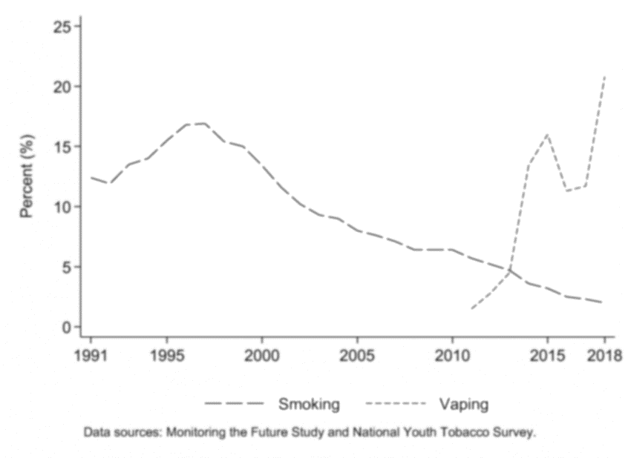
Tobacco and Electronic Vapor Products (EVPs)
10
Dave D, Dench D, Kenkel D, Mathios A, Wang H. News that Takes Your Breath Away: Risk Perceptions During an Outbreak of Vaping-related Lung Injuries. J Risk Uncertain. 2020;60(3):281-307. doi:10.1007/s11166-020-09329-2

Slide 12
Tobacco Product Use
Past Month Tobacco Product Use by Age Group in CT, 2011-2022
Note: Tobacco product use includes cigarettes, smokeless tobacco (i.e., snuff, dip, chewing tobacco, or snus), cigars, or pipe tobacco.
*State estimates for these years are no longer available due to methodological concerns with combining 2019 and 2020 data.
11
Source: NSDUH
Notes:
*State estimates for these years are no longer available due to methodological concerns with combining 2019 and 2020 data.
Tobacco use does not include e-cigarettes
Trending down

Slide 13
Tobacco Product Use Among High School Students
Percent of High School Students Reporting Past 30-Day Use of Electronic Vapor Products (EVPs) vs. Cigarettes
in CT, 2011-2021
Note: The language around electronic vapor products has changed over the years. In 2017 and earlier, the survey asked about
current “e-cigarette” use rather than vapor products.
*Caution should be taken when comparing CSHS 2021 data to that of previous years due to differences in methodology in survey collection.
12
Source: CSHS (CT YRBS)
Notes:
*Caution should be taken when comparing CSHS 2021 data to that of previous years due to differences in methodology in survey collection (presenting it in the fall of 2021 instead of the spring of 2021).
While tobacco use has been decreasing more students have been using e-cigarettes
Sudden decrease in 2021 could be impacted by COVID as methodology changed and survey was implemented in fall rather than spring which typically records lower rates of use

Slide 14
Tobacco Product Use by Sexual Identity
Percent of High School Students Reporting Past 30-Day Use of Electronic Vapor Products (EVPs) vs. Cigarettes in CT, 2021
13
Source: CSHS (CT YRBS) 2021
Notes:
Sexual minorities generally see higher rates
Difference is not very large for cigarettes but is almost twice the prevalence for EVPs

Slide 15

Substances Used in Vaping Devices
Substances Used in Vaping Devices by E-Cigarette Users Aged 18-25 in CT, 2020 (n=452)
14
Source: Young Adults Statewide Survey
Notes:
Other category: "something else“
YASS: Social media survey, done by CPES in 2020, administered through paid ads on Facebook. Funding source: block grant (DMHAS through SAMHSA funding)

Slide 16
Tobacco Sales Violations in CT
Reported Retailer Violations - Tobacco Sales to Individuals Under Legal Age in CT, 2013-2023
Note: TPEP Investigator noted that COVID impacted the rate significantly (e.g., investigations suspended for 2020, masks required in 2021). Implementation of Tobacco21, which raised the age for tobacco sales in October 2019, may also have had an impact.
*Data not available
**Results not final
15
Sources: SYNAR, CDC, CT DMHAS
Notes:
Defined by tobacco sales by minors
Trend fluctuates a lot
Age of legal tobacco use changed from 18 to 21 on October 1, 2019
Stopped doing compliance checks in 2020; hard to tell age when wearing masks

Slide 17
Key Takeaways: Tobacco and EVP
The use of tobacco products (excluding vaping) has been gradually decreasing over the years across all age groups in Connecticut, whereas the use of EVPs has continuously increased and exceeded the use of t0bacco in 2015 among high school students in Connecticut.
High school students who identified as LGB had a higher prevalence of past 30-day use of EVPs compared to high students who identified as heterosexual.
According to an online survey, over half of CT young adults who smoked e-cigarettes report using THC/marijuana oils in their vaping device.
Tobacco sales violations remained stable until 2020. This change can possibly be attributed to COVID.
16

Slide 18
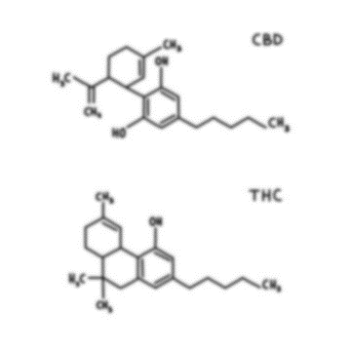
Cannabis and Marijuana
17

Slide 19
Marijuana Use
Past Month Marijuana Use by Age Group in CT and the US, 2015-2022
Past month marijuana/cannabis use for individuals aged 26 and older was similar between CT and the US (13.4% vs. 13.3% in 2021-22 period).
18
Note: *State estimates for these years are no longer available due to methodological concerns with combining 2019 and 2020 data.
Source: NSDUH
Notes:
*State estimates for these years are no longer available due to methodological concerns with combining 2019 and 2020 data.
State data = green; National data = blue
CT residents tend to have higher rates of marijuana compared to US

Slide 20
Perceived Risk from Smoking Marijuana, by Age Group
Percent of Persons Perceiving Great Risk from Smoking Marijuana Once Per Month in CT, 2015-2022
CT residents aged 18-25-years old have both the lowest perceived risk from smoking marijuana and the highest prevalence of past month marijuana use.
Note: The 2015 NSDUH underwent significant redesigns, including the order of perceived risk questions, affecting comparability.
*State estimates for these years are no longer available due to methodological concerns with combining 2019 and 2020 data.
19
Source: NSDUH
Notes:
*State estimates for these years are no longer available due to methodological concerns with combining 2019 and 2020 data.
National data for perceived risk from smoking marijuana (NSDUH) just in case it is needed:
2015-2016: 28.4%
2016-2017: 26.9%
2017-2018: 25.5%
2018-2019: 24.4%
2021-2022: 21.03%; 20.98% (12-17), 10.75% (18-25), 22.63% (26+)
Consider where decriminalization took place, legalization, etc, as well as legalization in surrounding states.
Discussion question: what do you think might be affecting the perceived risk from smoking marijuana?

Slide 21
Marijuana Use by Sexual Identity
Percent of High School Students Reporting Use of Marijuana in CT, 2021
20
Source: CSHS (CT YRBS) 2021
Notes:
Higher prevalence of risk factors related to substance use among LGB community in high school (be prepared to explain these risk factors in case somebody asks).

Slide 22
Cannabis Retail Sales: Products Sold
Number of Adult-Use Cannabis and Medical Marijuana Products Sold in CT by Month, 2023-2024
Note: “Other” products sold include pills, capsules, non-smokable infused extract, tincture, marijuana infused topicals, liquid marijuana Rick Simpson Oil (RSO),
marijuana mix infused, and lozenge.
21
Source: CT Department of Consumer Protection
Notes:
Sales for adult recreational use overtook medical marijuana use
Number of people enrolled in Connecticut’s Medical Marijuana Program decreased in 2023; renewal every year and there was a fee associated with it before legalization; may be decreasing because people do not see a need since it is legal;
The only people who enrolled in medical marijuana bought products in the other category
Discussion question: What do people think about this?

Slide 23
Key Takeaways: Cannabis and Marijuana
In Connecticut, perception of risk from smoking marijuana is showing a decreasing trend for all age groups.
  Further data is needed to illuminate cannabis use trends and perceptions in Connecticut post-legalization of adult-use cannabis.
There was a higher prevalence of past month marijuana use among Connecticut’s high school students who identify as LGB versus heterosexual students in 2021.
  A slightly higher percentage of Connecticut’s high school students who identify as LGB reported ever using synthetic marijuana than heterosexual students.
Adult-use cannabis products exceeded the sales of medical-use cannabis in May 2023 and the number of adult-use cannabis products sold continued to increase during the latter months of 2023.
22

Slide 24
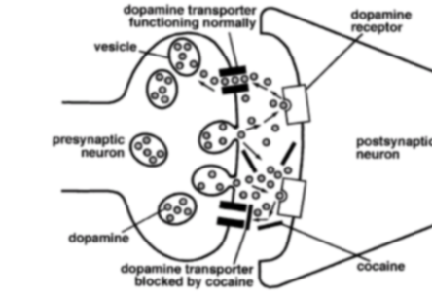
Cocaine
23

Slide 25
Cocaine Use
Percent Reporting Past Year Cocaine Use by Age Group in CT, 2011-2022
24
Note: *State estimates for these years are no longer available due to methodological concerns with combining 2019 and 2020 data.
Notes:
This slide shows that 18-25 year olds and adults 26+ are the groups at increased risk of cocaine use. Both have increased almost 50% since 2009-2010. Again adolescents are not sharing this risk; cocaine use among 12-17 year olds appears to have dropped slightly.
Note this is a smaller scale and fluctuations would be less prominent on larger scale
*State estimates for these years are no longer available due to methodological concerns with combining 2019 and 2020 data.

Slide 26
Cocaine-Involved Overdose Deaths
Number of Overdose Deaths by Year in CT, 2012-2022
25
Source: Office of the Chief Medical Examiner
Notes:
Deaths that involved cocaine based on toxicology report

Slide 27
Cocaine-Involved Overdose Mortality Rate: Community Types
Cocaine-Involved Overdose Mortality Rate (per 100,000) by 5 CT Community Types, 2012-2022
Note: Death rate by town of residence.
26
Source: Office of the Chief Medical Examiner
Notes:
Urban core has highest rate of cocaine-involved overdose
Gaps between community type has been widening over-time
Rates not percentages; changes in population accounted for

Slide 28
Cocaine-Involved Overdose Mortality Rate: Race/Ethnicity
Cocaine-Involved Overdose Mortality Rate (per 100,000) by Race/Ethnicity, 2012-2022
27
Source: Office of the Chief Medical Examiner
Notes:
Minority populations bore the brunt of harm reduction activities during COVID outreach and other COVID-related artifacts which may explain decrease in 2020

Slide 29
Key Takeaways: Cocaine
Past year cocaine use was most prevalent in young adults aged 18-25 in Connecticut.
Cocaine-involved overdose mortalities have continued to rise over the years in Connecticut.
Most cocaine-involved overdose mortalities have been seen in:
  Urban periphery areas
  Non-Hispanic Black/African American population
28

Slide 30
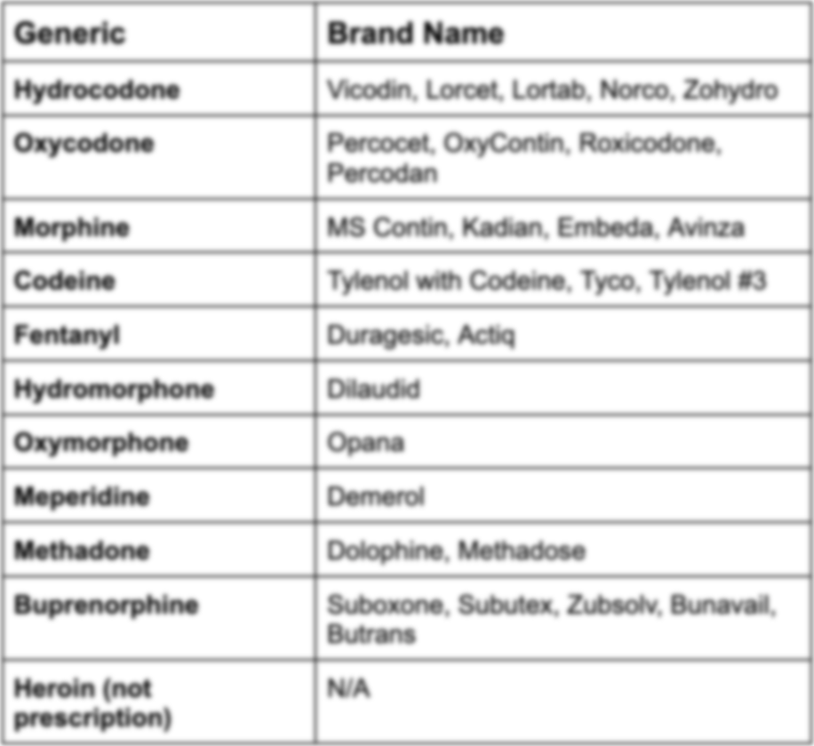
Prescription Pain Medications
29

Slide 31
Prescription Pain Medication Misuse
Percent of Persons Reporting Past Year Non-Medical Use of Pain Relievers by Age Group in CT, 2011-2022
30
Note: *State estimates for these years are no longer available due to methodological concerns with combining 2019 and 2020 data.
Source: NSDUH
Notes:
Trend data from the 2009-2016 NSDUH surveys show that uniformly over time young adults ages 18-25 have the highest rates of non-medical use of prescription drugs compared to adolescents ages 12-17 and adults 26 and older. While the rates of NMUPD appear relatively unchanged in the youth population, the rates of prescription misuse appeared to decline among young adults (11.1% in 2009-2010 to 7.18% in 2015-2016)
Opioid and non-opioid pain relievers prescribed by a doctor but not used under their direction. This does not include over the counter pain relievers.
*State estimates for these years are no longer available due to methodological concerns with combining 2019 and 2020 data.

Slide 32
Prescription Pain Medication Misuse Among High School Students
Percent of High School Students Reporting Ever Misusing Prescription Pain Medication, 2011-2021
Note: The wording of this question has changed over the years. In 2015 the question asked about taking prescription drugs without a prescription but didn’t specify pain medicine. In 2013 and earlier, it asked about taking drugs without a prescription to get high.
*Caution should be taken when comparing CSHS 2021 data to that of previous years due to differences in methodology in survey collection.
31
Notes:
Relatively stable in CT
Nationally generally shows a decreasing trend
CT is lower than US

Slide 33
Opioid Prescriptions in CT
Number of Opioid Prescriptions Per Year in CT, 2014-2022
32
Source: CPMRS, Department of Consumer Protection

Slide 34
Key Takeaways: Prescription Pain Medication
The percentage of Connecticut individuals reporting past year non-medical use of pain relievers has somewhat decreased across all age groups between 2011 and 2022.
  The prevalence of past year non-medical use of pain relievers has been consistently highest among individuals aged 18-25 during this time period.
The number of opioid prescriptions dispensed per year has been steadily decreasing since 2015.
  2015: 2,625,042 prescriptions
  2022: 1,608,256 prescriptions
33

Slide 35
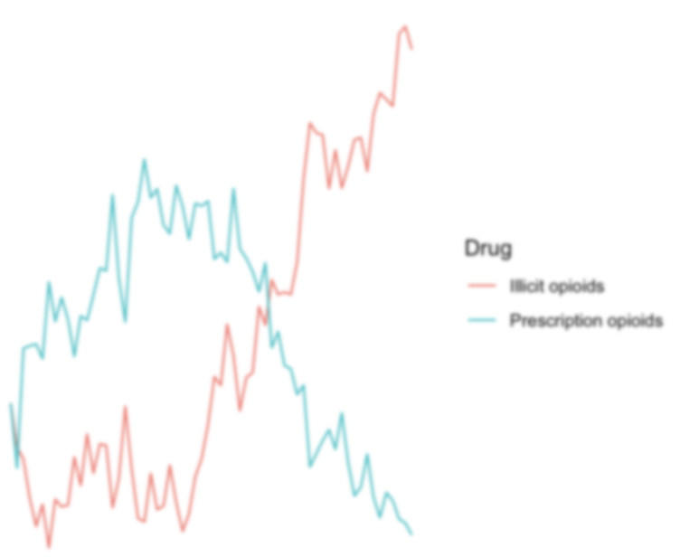
Opioids
34

Slide 36
Heroin Use
Percent of Persons Reporting Past Year Use of Heroin by Age Group in CT and the US, 2014-2022
Past year heroin use for ages 12-17 was extremely low for CT and US (below 0.2%). Estimates for ages 12-17 in 2021-2022 were not reported.
Note: Estimates for the 12-17 age group were not reported for both CT and the U.S. due to low precision.
*State estimates for these years are no longer available due to methodological concerns with combining 2019 and 2020 data.
35
Source: NSDUH
Notes:
Scale only goes to 2%
CT has higher rates than US in previous years but is more similar now

Slide 37
Opioid-Related Emergency Department Visits
Number of Opioid-Related Emergency Department Visits in CT, 2019-2022
36
Source: CHIME Discharge Data
Notes:
ED visits increased
Hospital Admissions stayed the same

Slide 38
Opioid-Involved Overdose Deaths
Number of Overdose Deaths by Year in CT, 2012-2022
37
Source: Office of the Chief Medical Examiner
Notes:
Mean number of substances involved in overdoses in 2012= 1.6 compared to 2.3 in 2018
(includes alcohol, fentanyl, heroin, cocaine, any benzodiazepine, prescription opioids (counted individually), methamphetamine, methadone)
Due to the way data was reported, fentanyl analogues were not included separately from fentanyl, and thus these counts represent underestimates, since decedents may have positive toxicology for 1 or more fentanyl analogue. Also, decedents may have had >1 benzodiazepine, and these were not able to be counted individually.

Slide 39

Drugs Identified in Fentanyl-Involved Overdose Deaths
Multiple Drugs Involved in Opioid Overdose Deaths in CT, 2022 (n = 1253)
Cocaine, 47%
Alcohol, 28%
Xylazine, 28%
Benzodiazepines,
30%
Fentanyl Only,
14%
Heroin, 9%
38
Prescription Opioids, 6%
Source: Office of the Chief Medical Examiner
Notes:
14% of the 1253 fentanyl-involved overdose deaths involved only fentanyl and no other substance.

Slide 40
Opioid-Involved Overdose Mortality Rate: Age Groups
Opioid-Involved Overdose Mortality Rate (per 100,000) by Age in CT, 2012-2022
39
Source: Office of the Chief Medical Examiner
Notes:
In the US in 2017, 68% of all overdose deaths involved opioids, compared to 92% and 93% of overdoses in CT in 2017 and 2018, respectively
Mortality is increasing for the middle age groups but is relatively stable for youngest and oldest.

Slide 41
Opioid-Involved Overdose Mortality Rate: Community Types
Opioid-Involved Overdose Mortality Rate (per 100,000) by 5 CT Community Types, 2012-2022
40
Note: Death rate by town of residence
Source: Office of the Chief Medical Examiner

Slide 42
Opioid Overdose Mortality Rate: Race/Ethnicity
Opioid Overdose Mortality Rate Per 100,000 by Race/Ethnicity in CT, 2012-2022
41
Source: Office of the Chief Medical Examiner

Slide 43
Drug Seizure Submissions
Connecticut Counts for the Most Frequently Identified Drugs, 2014-2022
*All fentanyl-related compounds includes:
fentanyl, 4-fluoroisobutyryl fentanyl, acetyl fentanyl, acryl fentanyl, carfentanil, cyclopropyl fentanyl, furanyl fentanyl, U-47700, ANPP, butyryl fentanyl, fluoroisobutyryl fentanyl, methoxyacetyl fentanyl, o-fluoro acryl fentanyl, valeryl fentanyl, p-fluoroisobutyryl fentanyl, and p-fluorobutyryl fentanyl.
42
Source: US DEA, Diversion Control Division, 2014-2022

Slide 44
Key Takeaways: Opioids
Fentanyl continues to be involved in the majority of substance overdose mortalities in Connecticut.
  Fentanyl has been the most frequently submitted substance to labs in recent years.
Opioid-involved overdose mortalities in Connecticut have been more prevalent among:
  Individuals aged 35-44
  Non-Hispanic Black population
  Urban core communities
Substance overdose mortalities in Connecticut often involve multiple substances (e.g., no heroin-involved overdose deaths in 2022 involved only heroin and no other substance).
The number of opioid-related emergency department (ED) visits in the state has increased since 2013.
  2013: 1,126 ED visits
  2022: 3,729 ED visits
Since 2020, Connecticut has seen a slight increase in the number of substances seized for both methamphetamine and cocaine.
43

Slide 45
Gaps, Limitations, and Looking Ahead
Most updated sub-state (regional) data from NSDUH are from 2016-2018, which is now outdated.
NSDUH data from 2019-2020 period are not available due to methodological concerns.
State reports of substance use and misuse on minority populations (such as LGBTQ+) are still limited.
Looking ahead
Fentanyl-involved overdose continues to be a public health crisis and needs to be rigorously addressed.
Post-legalization cannabis use in Connecticut requires continuous surveillance.
Further detailed data collection and reports within minority populations are needed to inform disparities.
Keep an eye on stimulants (e.g., cocaine, methamphetamine)
45

Slide 46
For more information, contact
Megan O'Grady: ogrady@uchc.edu
Jennifer Sussman: sussman@uchc.edu or visit the SEOW Prevention Data Portal at https://preventionportal.ctdata.org/

Slide 47
Extra slides

Slide 48
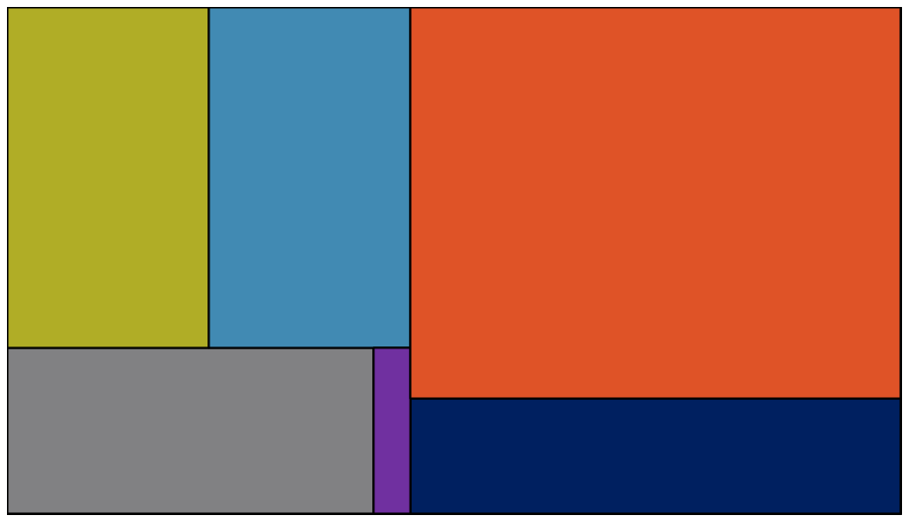
Drugs Identified in Heroin-Involved Overdose Deaths
Multiple Drugs Involved in Opioid Overdose Deaths in CT, 2022 (n = 125)
Alcohol, 34%
Cocaine, 34%
Fentanyl, 95%
There were 0 deaths involving heroin alone.
Benzodiazepines, 30%
Xylazine, 28%
Prescription Opioids, 3%
Source: Office of the Chief Medical Examiner
Notes:
All of the 125 heroin-involved overdose deaths in 2022 at least one other drug besides heroin.

Slide 49
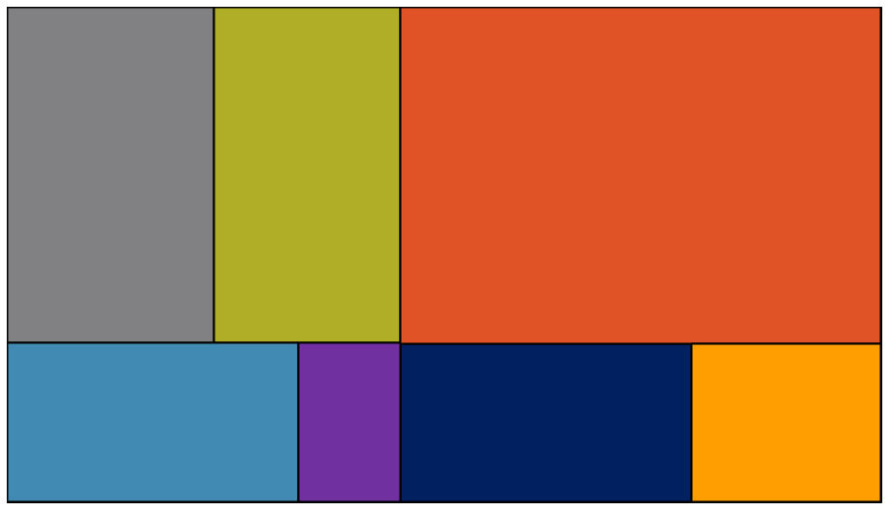
Drugs Identified in Prescription Opioid-Involved Overdose Deaths
Multiple Drugs Involved in Opioid Overdose Deaths in CT, 2022 (n = 112)
Benzodiazepines, 30%
Alcohol, 27%
Fentanyl, 70%
Alcohol, 34%
Cocaine, 34%
Fentanyl, 95%
Cocaine, 34%
Benzodiazepines, 30%
Xylazine, 28%
Heroin, 13%
Xylazine, 28%
Prescription Opioids Only, 7%
Source: Office of the Chief Medical Examiner
Notes:
7% of the 112 prescription opioid-involved overdose deaths involved only prescription opioids (NOTE: could involve multiple prescription opioids but no other substances)
112 CT overdose deaths involved prescription opioids

Slide 50

Drugs Identified in Heroin-Involved Overdose Deaths
Multiple Drugs Involved in Opioid Overdose Deaths in CT, 2019
Fentanyl, 88%
Cocaine, 37%
Alcohol, 26%
Only 3% of all heroin-involved overdose deaths are deaths involving only heroin and no other substance.
Benzodiazepines, 10%
Prescription
Opioids, 7%
Xylazine, 8%
Heroin,
3%
Source: Office of the Chief Medical Examiner

Slide 51
Opioid-Related Emergency Department Visits
Number of Opioid-Related Emergency Department Visits in CT, 2013-2022
36
Source: CT DPH
Notes:
ED visits increased
Hospital Admissions stayed the same

Slide 52
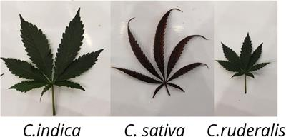


Cannabis and Marijuana: What’s the Difference?
Cannabis refers to all products derived from the Cannabis sativa, Cannabis indica, and Cannabis ruderalis plants.
Marijuana is comprised of parts of the Cannabis sativa plant and contains a high concentration of the psychoactive cannabinoid (compound) THC.
This presentation uses both the terms cannabis and marijuana as reflected by the methodology of how the data was collected.

Slide 53
Conclusions
Although there has been some decline in alcohol use among high school students, the prevalence in Connecticut overall remains greater than the national average.
Perception of risk from smoking marijuana is showing a decreasing trend for all age groups in Connecticut.
Adult-use cannabis products exceeded the sales of medical-use cannabis in May 2023.
Vaping/ENDS and Marijuana/Hashish/THC have been the top community concerns for youth aged 12-17 while alcohol and prescription drugs have been the top community concerns for older adults aged 66 or older in Connecticut.
Most cocaine-involved overdose mortalities have been seen in Connecticut’s urban periphery areas and have continued to rise over the years.
Fentanyl continues to be involved in most substance overdose mortalities in Connecticut.
  Fentanyl has been the most frequently submitted substance to labs in recent years.
Opioid-involved overdose mortalities are prevalent among:
  Adult population aged 35-44; Non-Hispanic Black population; Urban core areas
Substance overdose deaths in Connecticut often involve multiple substances (e.g., only 3% of all heroin-involved overdose deaths are deaths involving only heroin and no other substance).
44

